Slide 1
Robust Low-Light Image Enhancement via Generative Priors
Omar Khater
MSC Student
Department of Electrical and Computer Engineering

Slide 2
Agenda
Introduction
Methodology
Training
Evaluation
Results
Ablation Studies
Conclusion

Slide 3
Introduction

Slide 4
Low Light Image Enhancement (LLIE)
Low-level (pixel level) vision task
Goal is to transform poorly illuminated images into visually pleasant normal-light images.
Ill-posed problem: A problem that its solution lacks one of these conditions:
Existence ✓
Uniqueness ✗
Stability: The solution's behavior changes continuously with the initial conditions or input data (i.e., small changes in input lead to small changes in the solution). ✗

Slide 5

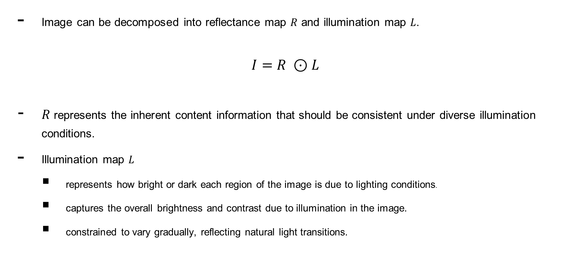
Retinex Theory
Image can be decomposed into reflectance map $R$ and illumination map $L$.
$$I=R ⊙L$$
$R$ represents the inherent content information that should be consistent under diverse illumination conditions.
Illumination map $L$
represents how bright or dark each region of the image is due to lighting conditions.
captures the overall brightness and contrast due to illumination in the image.
constrained to vary gradually, reflecting natural light transitions.
Hadamard product ($I_{ij}=R_{ij} ∗L_{ij})$
Land, E.H.: The retinex theory of color vision. Scientific American 237(6), 108–129 (1977) 1, 4, 5

Slide 6
LLIE Approaches
LLIE Apporaches
Hand Crafted Rules
Histogram Equalization (HE)
Retinex Theory
Learning
Supervised
Unsupervised
Semi-supervised
Other methods
et al. Jianghai. Lightendiffusion: Unsupervised low-light image enhancement with latent-retinex diffusion models.

Slide 7
LLIE Approaches
LLIE Apporaches
Hand Crafted Rules
Histogram Equalization (HE)
Retinex Theory
Others
LIME [14]
BrainRetinex [17]
SDDLLE
Change histogram distribution to improve the contrast [42, 44]
e.g., gamma correction and fusion based such as CDEF[30]

Slide 8
LLIE Approaches
LLIE Apporaches
Hand Crafted Rules
Histogram Equalization (HE)
Retinex Theory
Learning
Supervised
Unsupervised
Semi-supervised
Others
- No suitable prior for various illumination conditions because LLIE is ill-posed problem
- Less practical
et al. Jianghai. Lightendiffusion: Unsupervised low-light image enhancement with latent-retinex diffusion models.

Slide 9
LLIE Approaches
LLIE Apporaches
Hand Crafted Rules
Histogram Equalization (HE)
Retinex Theory
Learning
Supervised
Unsupervised
Semi-supervised
Others
Need paired data collection (low vs high images) → More labor work.
Overfitting problem → poor generalization to unseen images
Examples Include
RetinexNet [58]
KinD++ [74]
SMG [64]
PyDiff [76]
GSAD [20]
et al. Jianghai. Lightendiffusion: Unsupervised low-light image enhancement with latent-retinex diffusion models.

Slide 10
LLIE Approaches
LLIE Apporaches
Hand Crafted Rules
Histogram Equalization (HE)
Retinex Theory
Learning
Supervised
Unsupervised
Semi-supervised
Others
Better generalization but less stable training
Examples Include
Zero-DCE [12]
EnlightenGAN [24]
RUAS [32]
GDP [8]
PairLIE[10]
et al. Jianghai. Lightendiffusion: Unsupervised low-light image enhancement with latent-retinex diffusion models.

Slide 11
LLIE Approaches
LLIE Apporaches
Hand Crafted Rules
Histogram Equalization (HE)
Retinex Theory
Learning
Supervised
Unsupervised
Semi-supervised
Others
Better generalization and stable training but more complicated
Examples Include
DRBN [68]
BL [39]
et al. Jianghai. Lightendiffusion: Unsupervised low-light image enhancement with latent-retinex diffusion models.

Slide 12
Methodology

Slide 13
Baseline model
Non-learned Image Enhancer
Sequential Pixel‑Level Enhancements
Performs tensor‑level gamma correction (γ=0.7)
Brightness (2.5×), contrast (1.8×), saturation (1.2×), and sharpness (1.3×) adjustments.
Applies Contrast Limited Adaptive Histogram Equalization (CLAHE) with clip limit 2.0 and grid size 8 in LAB space to boost fine details and normalize illumination across low‑light regions.
Gamma Correction
CLAHE
Contrast Adjustments

Slide 14
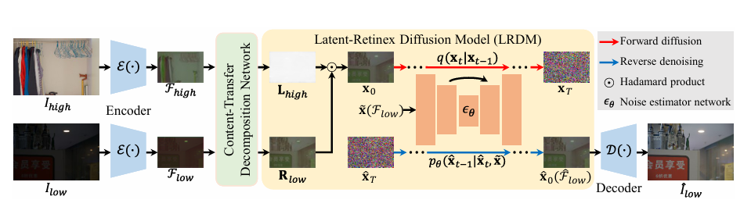
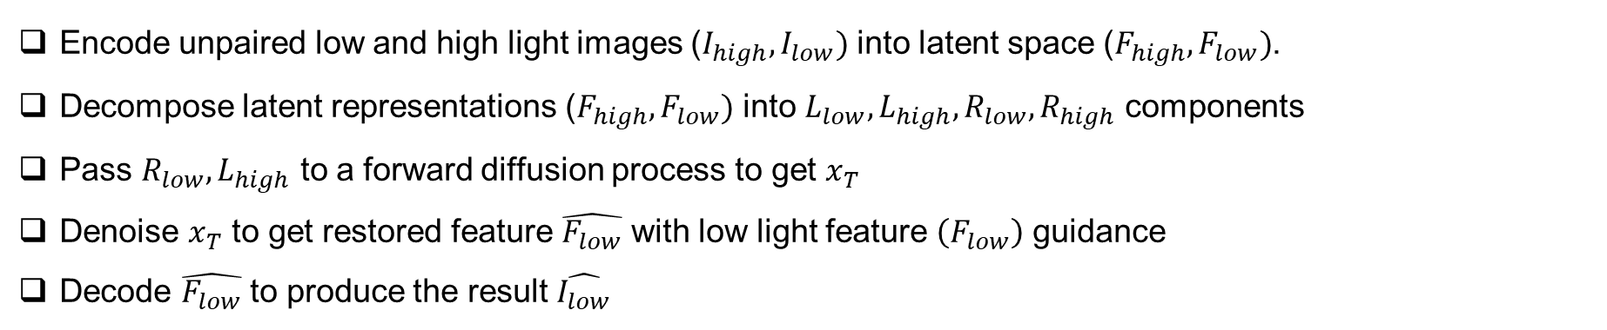
LightenDiffusion
Encode unpaired low and high light images ($I_{high}, I_{low})$ into latent space ($F_{high}, F_{low})$.
Decompose latent representations ($F_{high}, F_{low})$ into $L_{low}, L_{high}, R_{low}, R_{high}$ components
Pass $R_{low}, L_{high}$ to a forward diffusion process to get $x_{T}$
Denoise $x_{T}$ to get restored feature $\hat{F_{low}}$ with low light feature $\left(F_{low}\right)$ guidance
Decode $\hat{F_{low}}$ to produce the result $\hat{I_{low}}$
et al. Jianghai. Lightendiffusion: Unsupervised low-light image enhancement with latent-retinex diffusion models.

Slide 15
Training

Slide 16
Dataset
Name: Single Image Contrast Enhancement (SICE)
Description
large‑scale multi‑exposure image collection designed to train CNNs for single‑image contrast enhancement
Each image captured under multiple exposure settings
13 representative multi‑exposure fusion and HDR algorithms produce candidate enhanced images; the best of these (determined via subjective experiments) serves as the ground‑truth contrast reference
Purpose
Enables end‑to‑end learning of under‑/over‑exposure correction
Stats
258, 46 samples in train, test sets, respectively
Published public hugging face dataset card here
Cai 2018, Learning a Deep Single Image Contrast Enhancer from Multi-Exposure Images

Slide 17
Training Strategy
Stage 1
Paired Low Quality Images from SICE dataset
Stage 2
Paired low/normal light image pairs from SICE dataset
Optimize Encoder + CTDN + Decoder
Freeze the diffusion model
Optimize the diffusion model while freezing other modules.

Slide 18
Losses - Stage 1
$$ℒ_{dec}=ℒ_{rec}+ λ_{2 }ℒ_{ref}+λ_{3 }ℒ_{ill}$$
Overall decomposition loss used for training CTDN (Stage 1 objective)

Slide 19
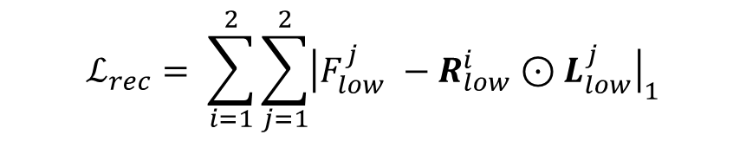
Losses - Stage 1
$$ℒ_{dec}=ℒ_{rec}+ λ_{2 }ℒ_{ref}+λ_{3 }ℒ_{ill}$$
Reconstruction loss – Aims to guarantee the decomposed components can reconstruct the input features
$$ℒ_{rec}= \sum_{i=1}^{2}{\sum_{j=1}^{2}{{\left|F_{low}^{j} −R_{low}^{i}⊙L_{low}^{j}\right|}_{1}}}$$

Slide 20
Losses - Stage 1
$$ℒ_{dec}=ℒ_{rec}+ λ_{2 }ℒ_{ref}+λ_{3 }ℒ_{ill}$$
Reflectance consistency loss – Aims to enforce the network to produce invariant reflectance maps
$ℒ_{ref}=$ ${\left|R_{low}^{1}−R_{low}^{2}\right|}_{1}$

Slide 21
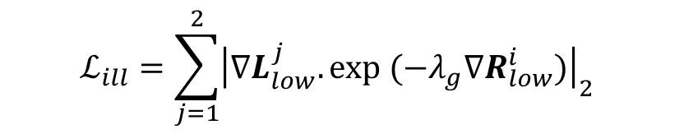
Losses - Stage 1
$$ℒ_{dec}=ℒ_{rec}+ λ_{2 }ℒ_{ref}+λ_{3 }ℒ_{ill}$$
Illumination smoothing loss – Aims to guarantee the illumination map to be local smoothness.
$$ℒ_{ill}=\sum_{j=1}^{2}{{\left|∇L_{low}^{j}. exp (−λ_{g}∇R_{low}^{i})\right|}_{2}}$$
Horizontal and vertical gradients
Balancing coefficient for perceived strength of the structure

Slide 22
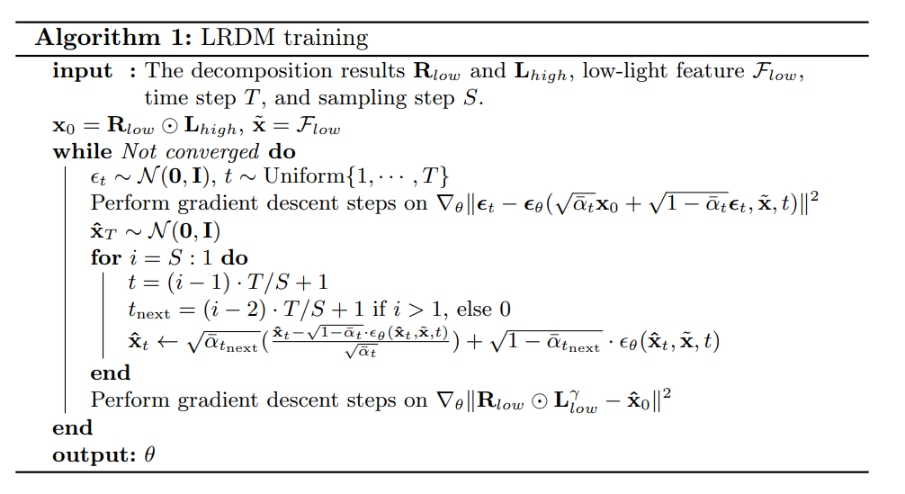
Stage 2 – LRDM Training Algorithm

Slide 23
Stage 2 – LRDM Training Algorithm

Slide 24

Losses - Stage 2
$$ℒ =ℒ_{diff}+ λ_{1 }ℒ_{scc}$$
Optimize parameters $Θ$ of the network $ε_{θ}$ to promote estimated noise vector close $ε_{θ}(x_{t}, \tilde{x}, t)$ to gaussian noise.
$ℒ_{diff}={\left|ε_{t} −ε_{θ}\left(x_{t}, \tilde{x}, t\right)\right|}_{2}$

Slide 25


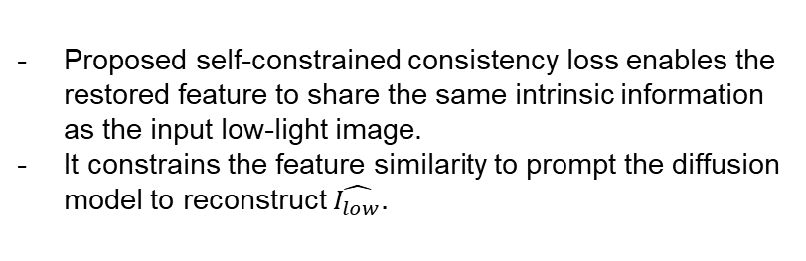

Losses - Stage 2
$$ℒ =ℒ_{diff}+ λ_{1 }ℒ_{scc}$$
Pseudo label
$\tilde{F_{low}}$ =$R_{low}^{i}⊙$ $L_{low}^{γ}$
Proposed self-constrained consistency loss enables the restored feature to share the same intrinsic information as the input low-light image.
It constrains the feature similarity to prompt the diffusion model to reconstruct $\hat{I_{low}}.$
$γ$ is illumination correction factor.
$ℒ_{scc}=$ ${\left|\tilde{F_{low}}− \hat{F_{low}}\right|}_{1}$

Slide 26
Evaluation

Slide 27
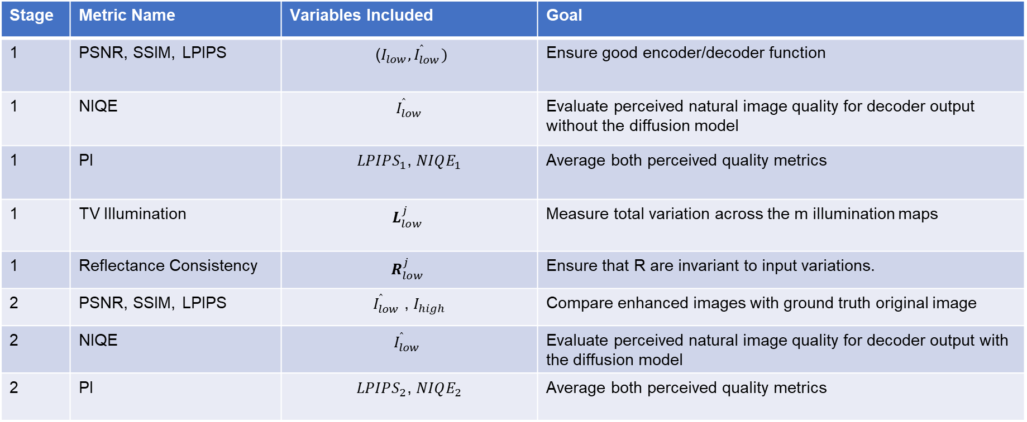
Evaluation Per Stage
Stage | Metric Name | Variables Included | Goal
1 | PSNR, SSIM, LPIPS | ($I_{low}, I_{low}^{ ̂})$ | Ensure good encoder/decoder function
1 | NIQE | $$I_{low}^{ ̂}$$ | Evaluate perceived natural image quality for decoder output without the diffusion model
1 | PI | $LPIPS_{1}$, $NIQE_{1}$ | Average both perceived quality metrics
1 | TV Illumination | $$L_{low}^{j}$$ | Measure total variation across the m illumination maps
1 | Reflectance Consistency | $$R_{low}^{j}$$ | Ensure that R are invariant to input variations.
2 | PSNR, SSIM, LPIPS | $I_{low}^{ ̂}$ , $I_{high}$ | Compare enhanced images with ground truth original image
2 | NIQE | $$I_{low}^{ ̂}$$ | Evaluate perceived natural image quality for decoder output with the diffusion model
2 | PI | $LPIPS_{2}$, $NIQE_{2}$ | Average both perceived quality metrics

Slide 28
Results

Slide 29
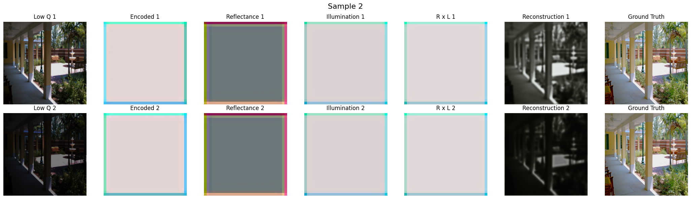
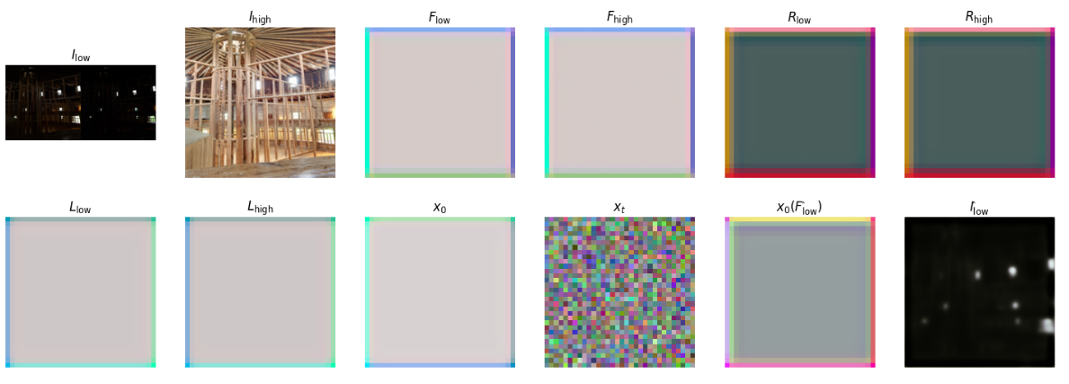
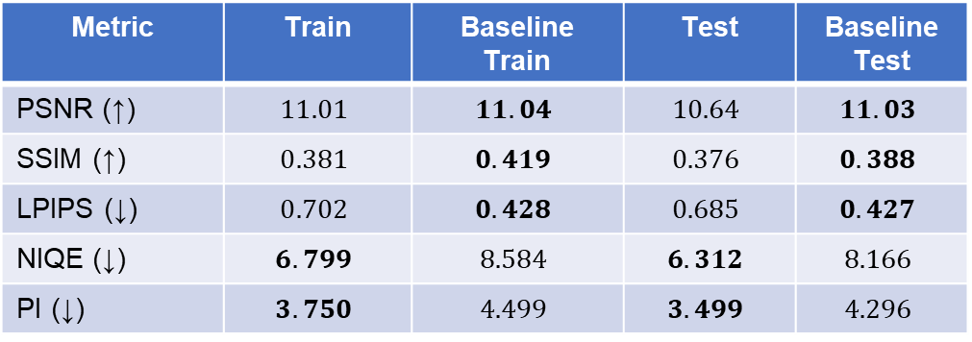
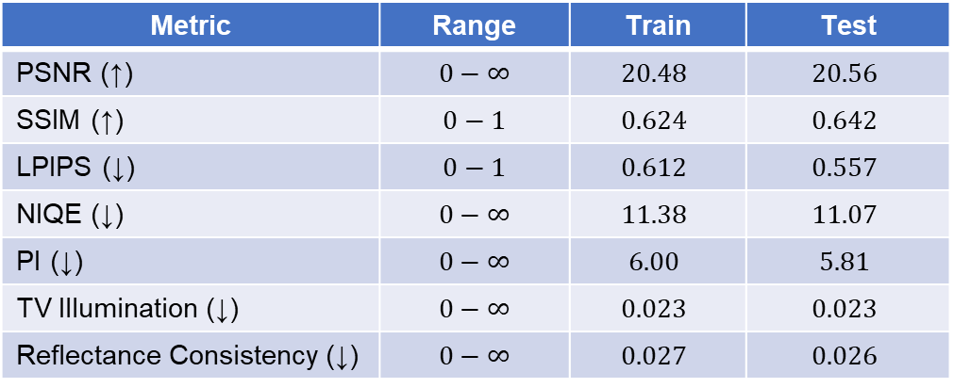
Initial Results
Metric | Range | Train | Test
PSNR (↑) | $$0−∞$$ | $$20.48$$ | $$20.56$$
SSIM (↑) | $$0−1$$ | $$0.624$$ | $$0.642$$
LPIPS (↓) | $$0−1$$ | $$0.612$$ | $$0.557$$
NIQE (↓) | $$0−∞$$ | $$11.38$$ | $$11.07$$
PI (↓) | $$0−∞$$ | $$6.00$$ | $$5.81$$
TV Illumination (↓) | $$0−∞$$ | $$0.023$$ | $$0.023$$
Reflectance Consistency (↓) | $$0−∞$$ | $$0.027$$ | $$0.026$$
Metric | Train | Baseline Train | Test | Baseline Test
PSNR (↑) | $$11.01$$ | $$11.04$$ | $$10.64$$ | $$11.03$$
SSIM (↑) | $$0.381$$ | $$0.419$$ | $$0.376$$ | $$0.388$$
LPIPS (↓) | $$0.702$$ | $$0.428$$ | $$0.685$$ | $$0.427$$
NIQE (↓) | $$6.799$$ | $$8.584$$ | $$6.312$$ | $$8.166$$
PI (↓) | $$3.750$$ | $$4.499$$ | $$3.499$$ | $$\text{4.296}$$

Slide 30
Analysis
Collapse in Stage 1: R, L maps are effectively constant
CTDN learned the trivial solution.
Hence, stage 2 does not perform as intended

Slide 31
Directions
Change stage 1 model parameters
Change loss weights
change number of attention heads
change latent space dimension
change encoder / decoder structure
…
Change stage 2 model parameters
Change loss weights
Change diffusion parameters
…
Learning Strategy
Objective metrics
Data Augmentation

Slide 32
Ablation Studies

Slide 33
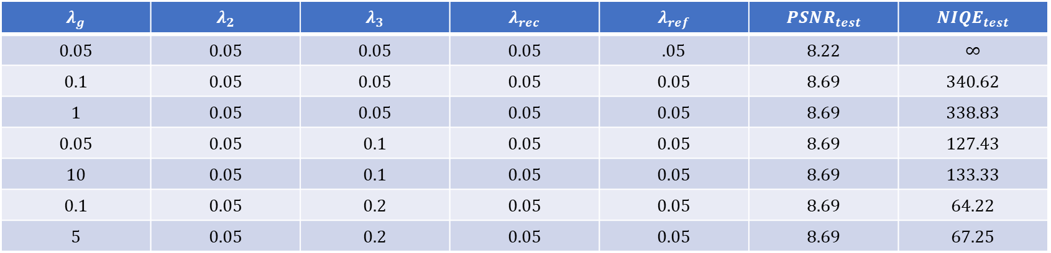
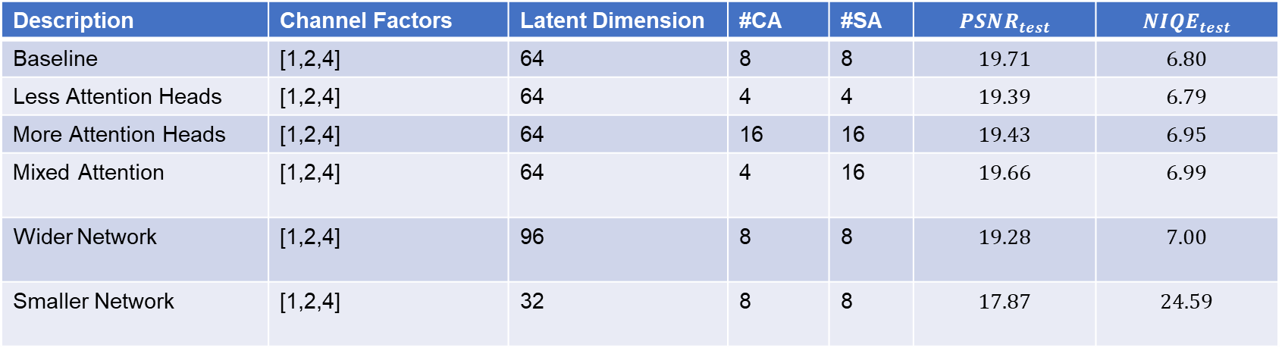
Stage 1
$$λ_{g}$$ | $$λ_{2}$$ | $$λ_{3}$$ | $$λ_{rec}$$ | $$λ_{ref}$$ | $$PSNR_{test}$$ | $$NIQE_{test}$$
$$0.05$$ | $$0.05$$ | $$0.05$$ | $$0.05$$ | $$.05$$ | $$8.22$$ | $$∞$$
$$0.1$$ | $$0.05$$ | $$0.05$$ | $$0.05$$ | $$0.05$$ | $$8.69$$ | $$340.62$$
$$1$$ | $$0.05$$ | $$0.05$$ | $$0.05$$ | $$0.05$$ | $$8.69$$ | $$338.83$$
$$0.05$$ | $$0.05$$ | $$0.1$$ | $$0.05$$ | $$0.05$$ | $$8.69$$ | $$127.43$$
$$10$$ | $$0.05$$ | $$0.1$$ | $$0.05$$ | $$0.05$$ | $$8.69$$ | $$133.33$$
$$0.1$$ | $$0.05$$ | $$0.2$$ | $$0.05$$ | $$0.05$$ | $$8.69$$ | $$64.22$$
$$5$$ | $$0.05$$ | $$0.2$$ | $$0.05$$ | $$0.05$$ | $$8.69$$ | $$67.25$$
Description | Channel Factors | Latent Dimension | #CA | #SA | $$PSNR_{test}$$ | $$NIQE_{test}$$
Baseline | [1,2,4] | 64 | 8 | 8 | $$19.71$$ | $$6.80$$
Less Attention Heads | [1,2,4] | 64 | 4 | 4 | $$19.39$$ | $$6.79$$
More Attention Heads | [1,2,4] | 64 | 16 | 16 | $$19.43$$ | $$6.95$$
Mixed Attention | [1,2,4] | 64 | 4 | 16 | $$19.66$$ | $$6.99$$
Wider Network | [1,2,4] | 96 | 8 | 8 | $$19.28$$ | $$7.00$$
Smaller Network | [1,2,4] | 32 | 8 | 8 | $$17.87$$ | $$24.59$$

Slide 34
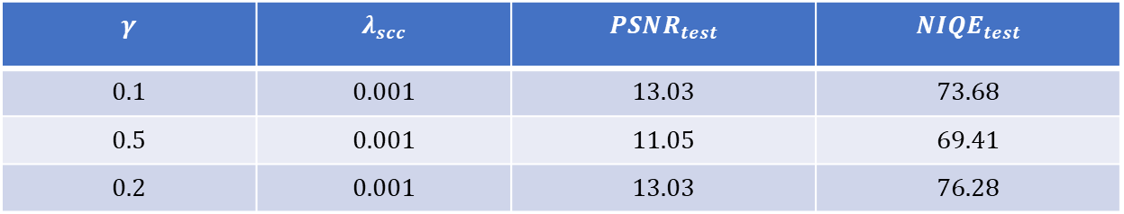
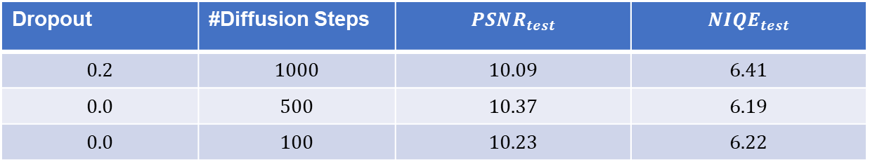
Stage 2
Dropout | #Diffusion Steps | $$PSNR_{test}$$ | $$NIQE_{test}$$
$$0.2$$ | $$1000$$ | $$10.09$$ | $$6.41$$
$$0.0$$ | $$500$$ | $$10.37$$ | $$6.19$$
$$0.0$$ | $$100$$ | $$10.23$$ | $$6.22$$
Architecture parameters sensitivity
$$γ$$ | $$λ_{scc}$$ | $$PSNR_{test}$$ | $$NIQE_{test}$$
$$0.1$$ | $$0.001$$ | $$13.03$$ | $$73.68$$
$$0.5$$ | $$0.001$$ | $$11.05$$ | $$69.41$$
$$0.2$$ | $$0.001$$ | $$13.03$$ | $$76.28$$
Loss Weights Sensitivity

Slide 35
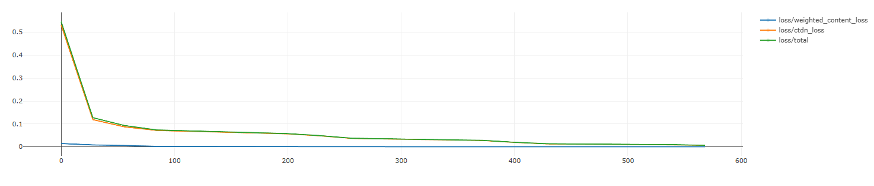
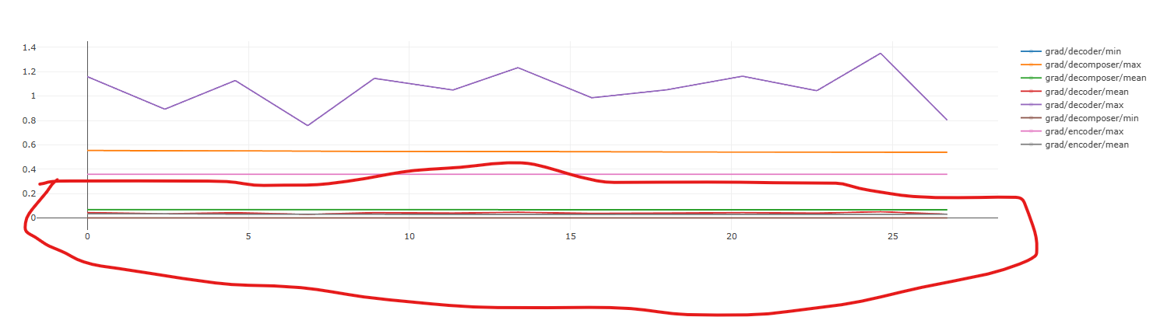
Joint-Training Problem
Need careful tuning for loss weight
One loss can easily dominate the others.
Here, Encoder & Decoder dominates CTDN.

Slide 36
Learning Strategy – Stage 1
Hand-tuned loss weights: manually or Bayesian search over loss weights
Three-Phase Curriculum
Phase 1 to train encoder + decoder (content loss only)
Phase 2 to train CTDN only
Phase 3 for joint training
Adaptive GradNorm Integration
Introduced learnable log-weights and a grad norm step to equalize gradient norms dynamically
Plateau‑Driven Curriculum GradNorm Trainer

Slide 37
Plateau‑Driven Curriculum GradNorm Trainer
Dynamic log‑weights: each loss term is scaled by a learnable log‑weight.
Validation‑driven curriculum: optimize only the content loss until its improvement stalls, then trigger a smooth ramp‑up of the CTDN‑specific losses.
Configurable CTDN ramp‑up: gradually introduce content losses.
Periodic GradNorm rebalancing: every few batches, adjust task weights based on gradient magnitudes to keep multi‑objective training balanced.

Slide 38
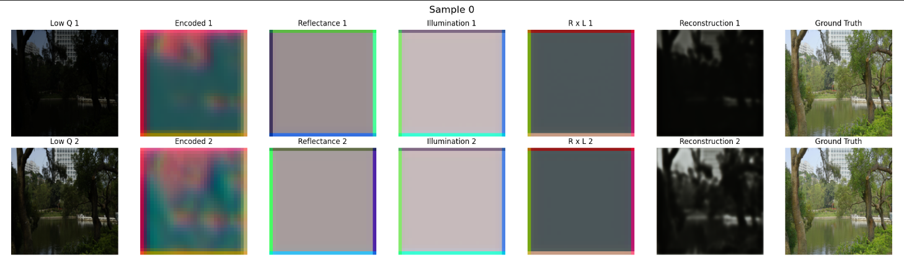
Efficiency
Some Improvements in the Encoder/Decoder learning
Still need further work to give the CTDN branch a fighting chance.

Slide 39
Conclusions

Slide 40
Conclusion
Novel Strategy for Stage-1 Stability
Curriculum-driven, GradNorm-enhanced training strategy with dynamic log-weights, which improves encoder-decoder learning and better prepares Stage-2 models
CTDN Remains a Bottleneck
Despite structural improvements, CTDN often collapses to trivial reflectance maps—future work must impose stronger semantic or perceptual constraints

Slide 41
Questions?

Slide 42
References
Zhenqi Fu1 2024, Learning a Simple Low-light Image Enhancer from Paired Low-light Instances.
Cai 2018, Learning a Deep Single Image Contrast Enhancer from Multi-Exposure Images
Jianghai 2024, Lightendiffusion: Unsupervised low-light image enhancement with latent-retinex diffusion models.
Land, E.H.: The retinex theory of color vision. Scientific American 237(6), 108–129 (1977) 1, 4, 5

Slide 43
Supplemental Slides

Slide 44
Quantitative Metrics
Common LLIE Metrics
Supervised
PSNR
SSIM
Unsupervised
NIQE
LPIPS
PI

Slide 45

Quantitative Metrics
$$\text{PSNR}\left(I,\hat{I}\right)=10⋅\log_{10}\left(\frac{{\text{MAX}}_{I}^{2}}{\text{MSE}\left(I,\hat{I}\right)}\right)$$
$$\text{MSE}\left(I,\hat{I}\right)=\frac{1}{mn}\sum_{i=1}^{m}{\sum_{j=1}^{n}{{\left[I\left(i,j\right)−\hat{I}\left(i,j\right)\right]}^{2}}}$$
Common LLIE Metrics
Supervised
PSNR
SSIM
Unsupervised
NIQE
LPIPS
PI
Stands for Peak signal-to-noise ratio.
Measures pixel-wise similarity between two images.
Higher value indicates greater similarity (less error).
Does not fully reflect human perception.

Slide 46
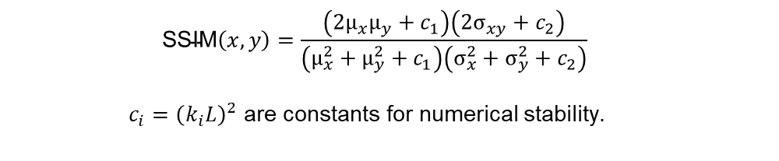
Quantitative Metrics
$$\text{SSIM}\left(x,y\right)=\frac{\left(2μ_{x}μ_{y}+c_{1}\right)\left(2σ_{xy}+c_{2}\right)}{\left(μ_{x}^{2}+μ_{y}^{2}+c_{1}\right)\left(σ_{x}^{2}+σ_{y}^{2}+c_{2}\right)}$$
$c_{i}={\left(k_{i}L\right)}^{2}$ are constants for numerical stability.
Common LLIE Metrics
Supervised
PSNR
SSIM
Unsupervised
NIQE
LPIPS
PI
Stands for Structural Similarity index.
Measures similarity in terms of luminance, contrast, and structure.
Values range between 0 and 1 (closer to 1 is better).
Better correlated to human visual perception than PSNR.

Slide 47
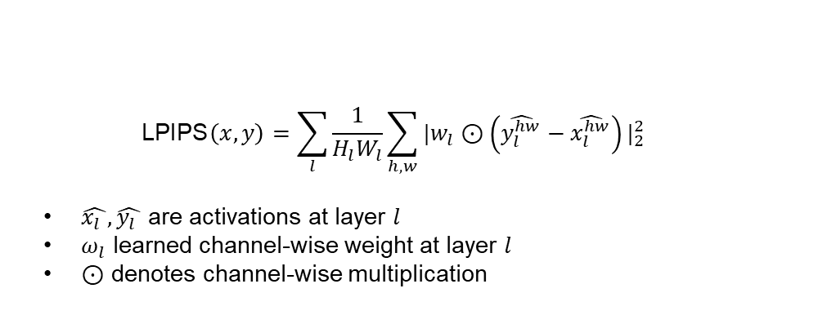
Quantitative Metrics
$$\text{LPIPS}\left(x,y\right)=\sum_{l}{\frac{1}{H_{l}W_{l}}\sum_{h,w}{|w_{l}}}⊙\left(\hat{y_{l}^{hw}}−\hat{x_{l}^{hw}}\right)|_{2}^{2}$$
$\hat{x_{l} },\hat{y_{l} }$ are activations at layer $l$
$ω_{l}$ learned channel-wise weight at layer $l$
$⊙$ denotes channel-wise multiplication
Common LLIE Metrics
Supervised
PSNR
SSIM
Unsupervised
NIQE
LPIPS
PI
Stands for Learned Perceptual Image Patch Similarity.
Measures perceptual similarity based on features learned by deep neural networks.
Lower LPIPS indicates better perceptual similarity.
Closely aligned with human visual judgment.

Slide 48
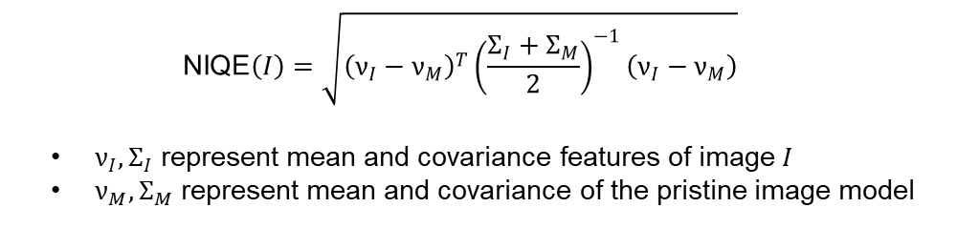
Quantitative Metrics
$$\text{NIQE}\left(I\right)=\sqrt{{\left(ν_{I}−ν_{M}\right)}^{T}{\left(\frac{Σ_{I}+Σ_{M}}{2}\right)}^{−1}\left(ν_{I}−ν_{M}\right)}$$
$ν_{I}, Σ_{I}$ represent mean and covariance features of image $I$
$ν_{M}, Σ_{M}$ represent mean and covariance of the pristine image model
Common LLIE Metrics
Supervised
PSNR
SSIM
Unsupervised
NIQE
LPIPS
PI
Stands for Natural Image Quality Evaluator.
no-reference metric assessing the "naturalness" of images based on natural scene statistics.
Lower NIQE indicates higher perceived natural image quality.
Does not require ground-truth images.

Slide 49
Quantitative Metrics
$$\text{PI}=\frac{1}{2}\left(\text{NIQE}+\text{LPIPS}\right)$$
Common LLIE Metrics
Supervised
PSNR
SSIM
Unsupervised
NIQE
LPIPS
PI
Stands for Perceptual Index.
A composite metric combining perception-based measures like NIQE and other perceptual quality scores.
Lower PI value indicates higher perceptual quality.
Commonly used to balance multiple aspects of visual quality.

Slide 50
Diffusion-Based Image Restoration
Diffusion Based Image Restoration
Conditional Mechanisms
Zero-shot
Guidance Mechanisms
Latent Diffusion Models
Hybrid Methods

Slide 51
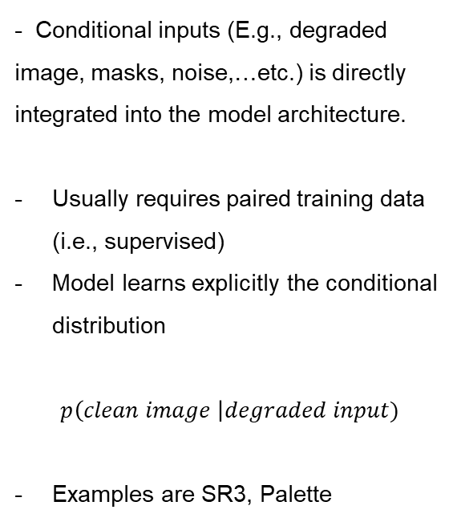
Diffusion-Based Image Restoration
- Conditional inputs (E.g., degraded image, masks, noise,…etc.) is directly integrated into the model architecture.
Usually requires paired training data (i.e., supervised)
Model learns explicitly the conditional distribution
$$p\left(clean image \right|degraded input)$$
Examples are SR3, Palette
Diffusion Based Image Restoration
Conditional Mechanisms
Zero-shot
Guidance Mechanisms
Latent Diffusion Models
Hybrid Methods

Slide 52
Diffusion-Based Image Restoration
Uses pretrained unconditional diffusion models directly at test-time without retraining.
Always unsupervised.
Examples are DDRM, DDNM, ILVR
Diffusion Based Image Restoration
Conditional Mechanisms
Zero-shot
Guidance Mechanisms
Latent Diffusion Models
Hybrid Methods

Slide 53
Diffusion-Based Image Restoration
Diffusion Based Image Restoration
Conditional Mechanisms
Zero-shot
Guidance Mechanisms
Latent Diffusion Models
Hybrid Methods
Utilize external guidance signals or classifier-free guidance mechanisms to steer the diffusion process towards restored images.
Can be supervised or unsupervised.
Examples are Classifier-free guidance and Guided Diffusion

Slide 54
Diffusion-Based Image Restoration
Diffusion Based Image Restoration
Conditional Mechanisms
Zero-shot
Guidance Mechanisms
Latent Diffusion Models
Hybrid Methods
Perform restoration in a compressed latent space.
Can be supervised or unsupervised.
Examples are Stable Diffusion for Restoration

Slide 55
Diffusion-Based Image Restoration
Diffusion Based Image Restoration
Conditional Mechanisms
Zero-shot
Guidance Mechanisms
Latent Diffusion Models
Hybrid Methods
Combine pretrained diffusion priors with classical iterative methods or optimization techniques
Examples are DiffPIR (Diffusion Plug-and-play Image Restoration), DPS (Diffusion Posterior Sampling).

Slide 56

Stage 2 - Inference
Obtain restored feature $\hat{F_{low}}$ from the distribution learned by the diffusion model with implicit sampling strategy.
Send $\hat{F_{low}}$ to the decoder to produce the result $\hat{I_{low}}$

Slide 57
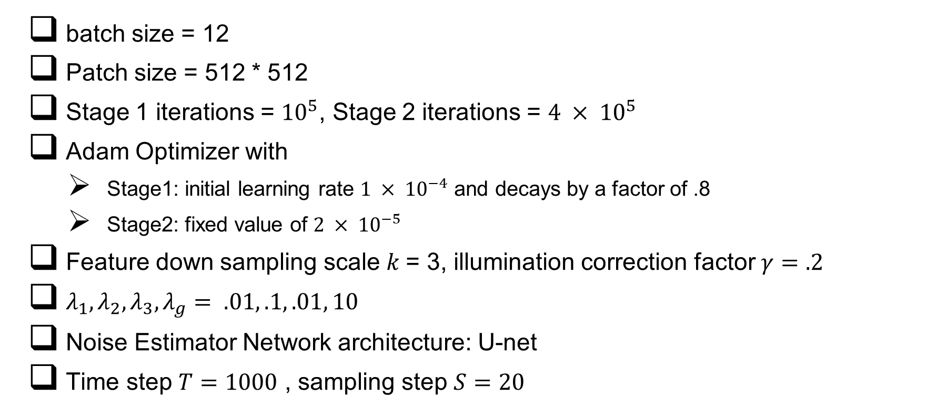
Training – Implementation Details
batch size = 12
Patch size = 512 * 512
Stage 1 iterations = ${10}^{5}$, Stage 2 iterations = $4 × {10}^{5}$
Adam Optimizer with
Stage1: initial learning rate $1 × {10}^{−4}$ and decays by a factor of .8
Stage2: fixed value of $2 × {10}^{−5}$
Feature down sampling scale $k$= 3, illumination correction factor $γ=.2$
$λ_{1},λ_{2},λ_{3},λ_{g}= .01, .1, .01, 10$
Noise Estimator Network architecture: U-net
Time step $T=1000$ , sampling step $S=20$

